Slide 1
Chapter 48
Atomic Structure

Slide 2
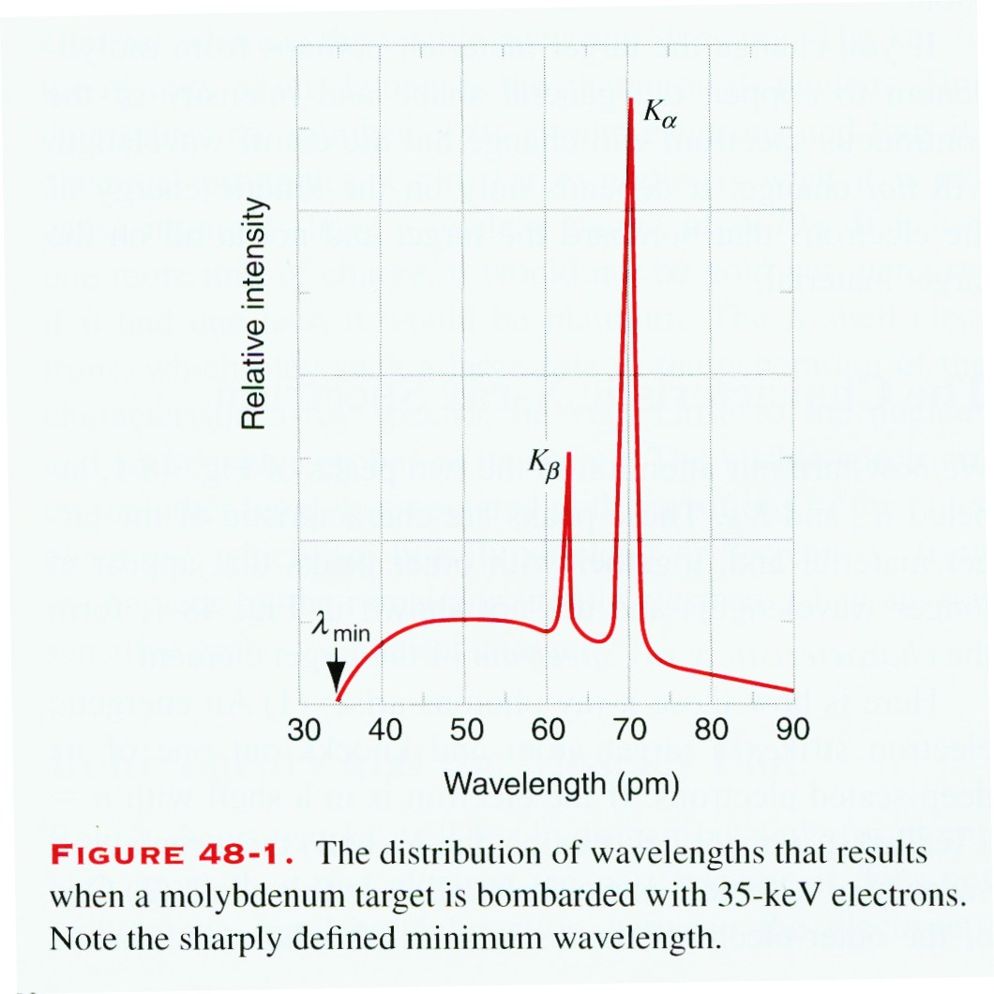
48-1 The X-Ray Spectrum of Atoms
An electron transits to deep levels in many electron atom.
The binding energy in the innermost shell is higher than that in outside shell. For example, outside 5eV, innermost 70keV.

Slide 3
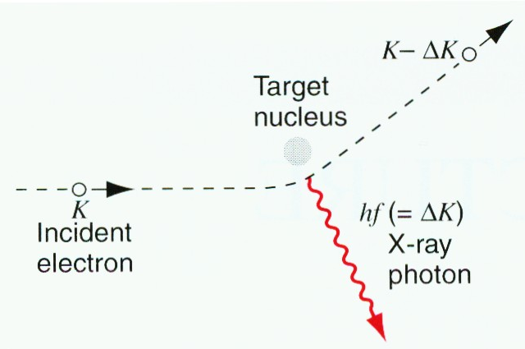
48-1 The X-Ray Spectrum of Atoms
The Continuous X-ray Spectrum (bremsstrahlung)
Continuous spectrum is due to the loss of kinetic energy of incident electrons. The kinetic energy transfers to radiation, photons. The minimum λ_{min} corresponds to the loss of all incident energy . It is independent of materials.

Slide 4
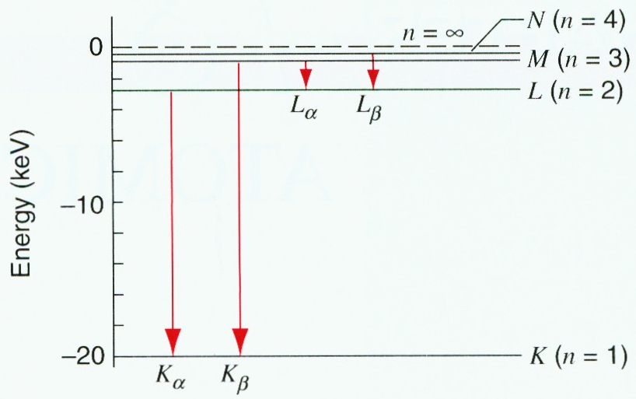
48-1 The X-Ray Spectrum of Atoms
The Characteristic X-ray Spectrum
Two peaks, together with other peaks, depend on the materials.
The reason is:
1) An energetic electron strikes a target atom and knocks out one of its deep-seated electrons and left a hole.

Slide 5
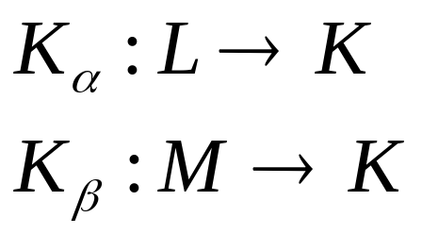
48-1 The X-Ray Spectrum Of Atoms
2) One of the outer electrons moves in to fill this hole and, in the process, the atom emits a characteristic x-ray photon.
K, L, M…are labeled the principle shells of electrons.
L shell transit to K shell, leaves a hole in L shell, and fills by further outer electron.
Sample problem 48-1

Slide 6
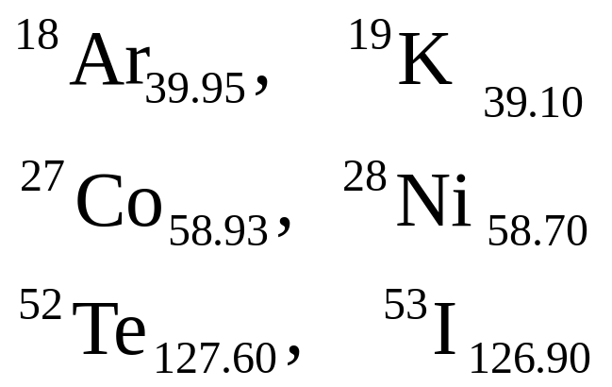
48-2 X Rays and the Numbering of the Elements
From the time of Mendeleev (1834-1907) the elements were listed in the periodic table in the order of increasing atomic weight. However, one difficulty still exists, that is, in several cases, the strict order of increasing atomic weights had to be reversed to maintain the similarity of chemical properties in the vertical columns of the table.
For example:

Slide 7
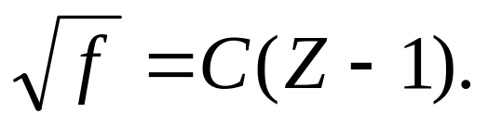
48-2 X Rays and the Numbering of the Elements
The young British physicist H. G. J. Moseley first introduced the concept of atomic number (symbol Z) and showed that these difficulties were removed if the periodic table was organized in order of increasing Z.
In experiments Moseley found that for a given x-ray spectrum line such as K_{α}, the square root of its frequency against the position of the associated element in the periodic table, a straight line resulted.

Slide 8
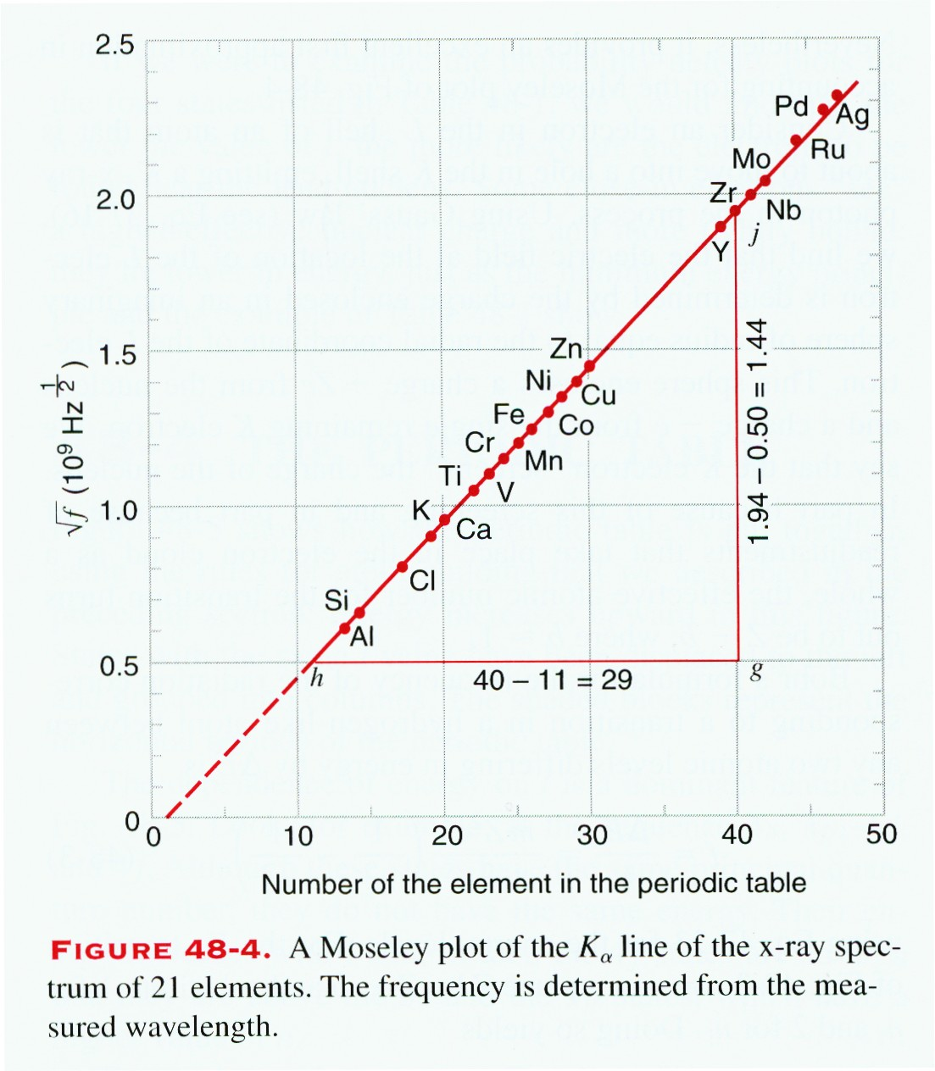
48-2 X Rays and the Numbering of the Elements
We have here a proof that there is in the atom a fundamental quantity, which increases by regular steps as we pass from one element to the next. This quantity can only be the charge on the central atomic nucleus.
Z is the numerical position of the element in the periodic table.

Slide 9
48-2 X Rays and the Numbering of the Elements
It is not hard to see why the characteristic x-ray spectrum shows such remarkable regularities from element to element whereas the visible spectrum does not. The key to the identity of an element is the charge on its nucleus. This determines the number of its atomic electrons and thus its chemical properties. Gold, for example, is what it is because its atoms have a nuclear charge of +79e. If it had one more unit of charge, it would not be gold but mercury; if it had one less, it would be platinum. The K-shell electrons, which play such a large role in the generation of the characteristic x-ray spectra, lie very close to the nucleus and are sensitive probes of its charge. The visible spectrum, on the other hand, is associated with transitions of the outer electrons, which are heavily shielded or “ screened” from the nucleus by the remaining atomic electrons; they are not sensitive probes of nuclear charge.

Slide 10
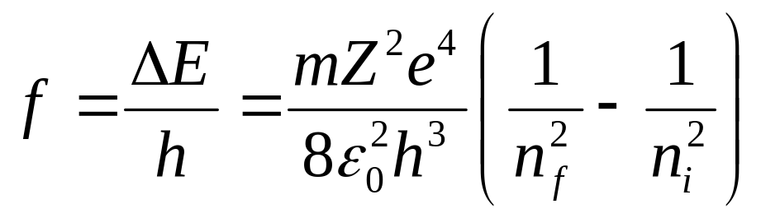
48-2 X Rays and the Numbering of the Elements
Bohr Theory and the Moseley Plot
Consider an electron in the L shell of an atom that is about to move into a hole in the K shell, emitting a K_{α} x-ray photon in the process.
The effective charge is (Z-b)e, as shown in the figure b≈1. It may be other value for different configuration.
+Ze
Replace Z by Z-b, we obtain

Slide 11
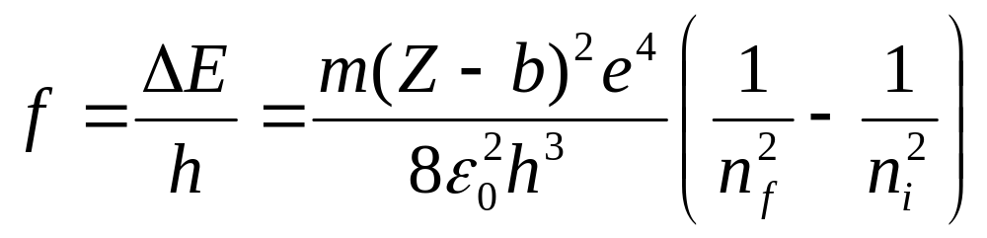
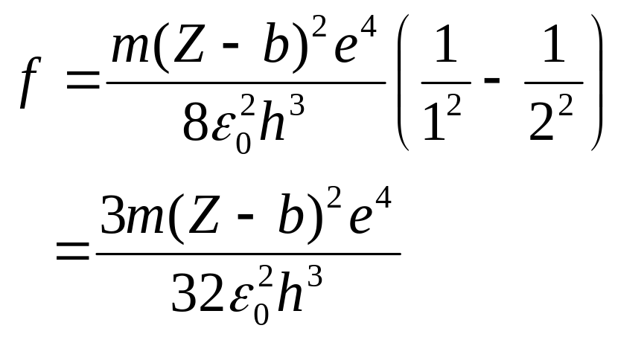
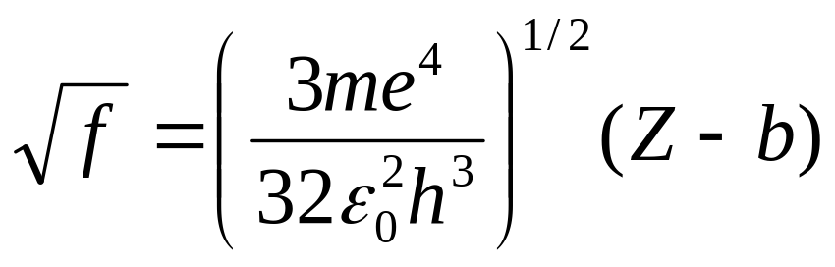
48-2 X Rays and the Numbering of the Elements
(48-3)
For K_{α} x-ray n_{f}=1, n_{i}=2
(48-4)

Slide 12
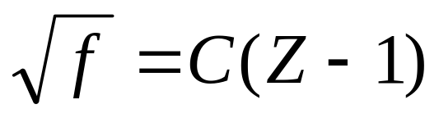
48-2 X Rays and the Numbering of the Elements
For a hole in K shell, b=1, then Moseley law results
(48-5)
Equation 48-5 represents a straight line, in full agreement with the experimental data of Fig.48-4.

Slide 13
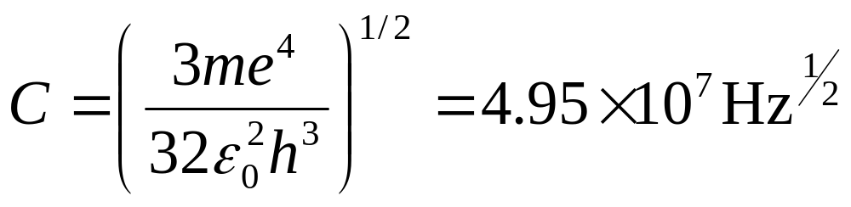
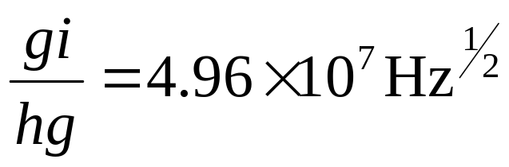
48-2 X Rays And the Numbering of the Elements
Sample-problem 48-2
According to the Bohr theory,
The slope of straight ling in Fig 48-4 is
How it is agreement!

Slide 14
48-3 Building Atoms
Building atoms by the following three rules
1) The quantum number principle:
There are 4 quantum numbers ---- n l m_{l} m_{s}.
2) The Pauli exclusion principle:
In multielectron atom, no two electrons can have the same set of quantum numbers (n l m_{l} m_{s}).
3) The minimum energy principle:
In adding an electron, put it in whatever vacant quantum state leads to an atom that is lowest in energy.
n—principle shell; l--subshell

Slide 15
48-4 The Periodic Table
Electron Configurations of the Elements
The maximum number of electrons in a given subshell is 2(2l+1). That is, 2 for s states (l=0), 6 for p states (l=1), 10 for d states (l=2), and 14 for f states (l=3).
For instance
Fluorine Z= 9 1s² 2s² 2p⁵
Neon Z=10 1s² 2s² 2p⁶
Sodium Z=11 1s² 2s² 2p⁶3s¹
Exceptions: for example Cu(Z=29), according to Fig.48-5 it should be 1s² 2s² 2p⁶3s²3p⁶4s²3d⁹ ,
but 1s² 2s² 2p⁶3s²3p⁶3d¹⁰4s¹.

Slide 16
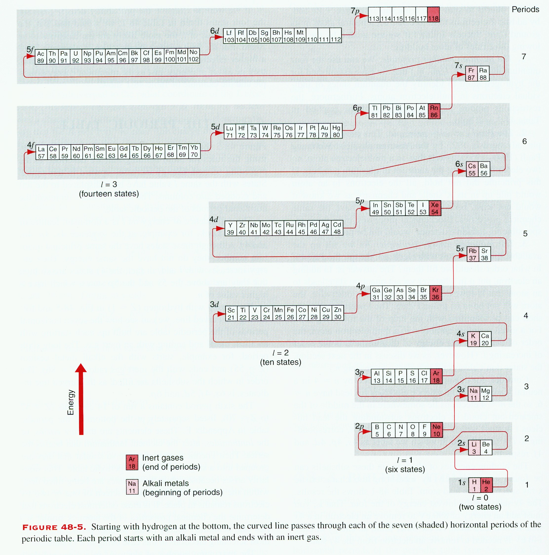

Slide 18
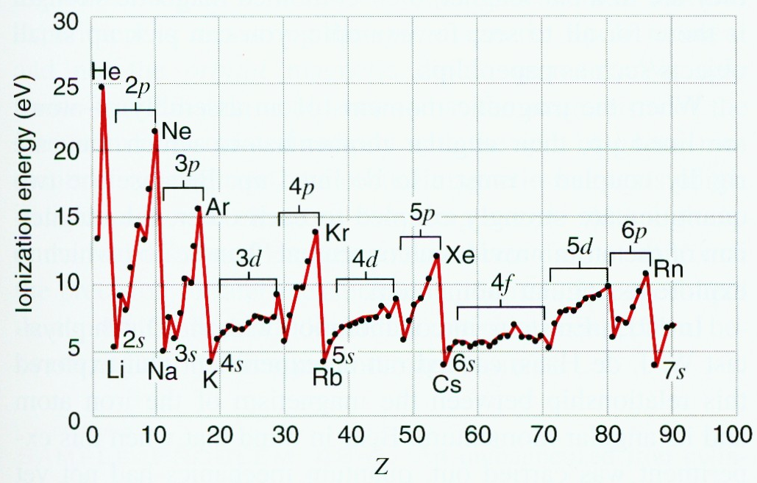
48-4 The Periodic Table
Ionization energy
The energy required to remove the least tightly bound electron from an atom in its ground state is called ionization energy.

Slide 19
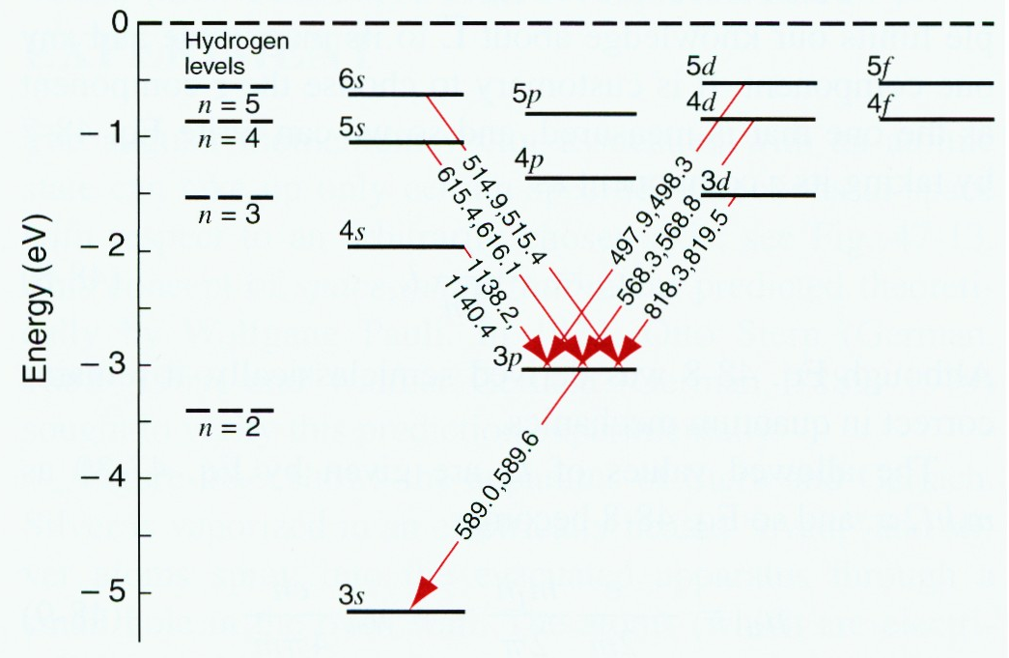
48-4 The Periodic Table
Excited States and Optical Transition

Slide 20
48-4 The Periodic Table
The electron in excited state drops back to its ground state, it emits radiation whose photon energy (which is equal to the difference between the energies of the excited state and the ground state) is in the eV range, corresponding to visible light. For this reason, such change in the state of the electron are called optical transitions.
Selection rule
The orbital angular momentum quantum number of the electron making the transition must change by a single unit only; that is
Δl = ±1

Slide 21

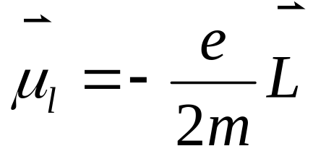
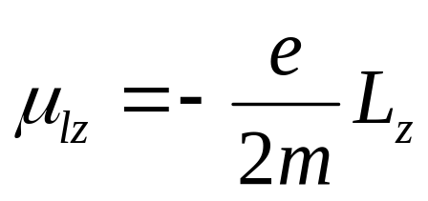
48-5 Atomic Magnetism
How to study the angular momentum properties of the atom ?
It is usually directly studied by placing the atom in a magnetic field.
View as current loop
(48-7)
where µ_{l} is a vector that represents the magnetic dipole moment and L is the orbital angular momentum vector of the electron.
The component of z direction
(48-8)

Slide 22
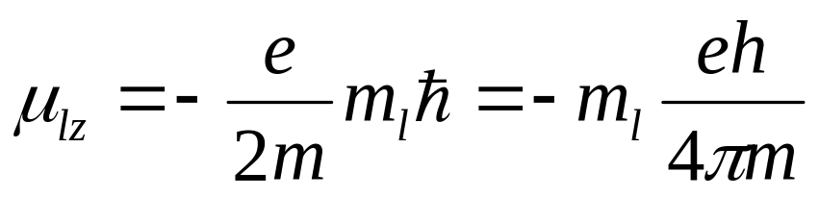
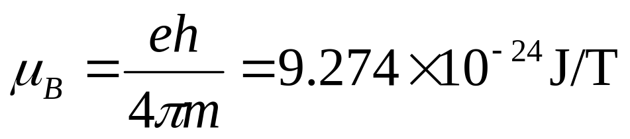
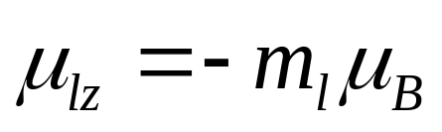
48-5 Atomic Magnetism
L_{z}=m_{l}ħ, m_{l}=-l, -(l-1), ...-1, 0, +1, ..., +l
(48-9)
It can be expressed by Bohr magnetron µ_{B}
(48-10)
We can express the magnetic dipole moment in terms of the Bohr magnetron
(48-11)

Slide 23


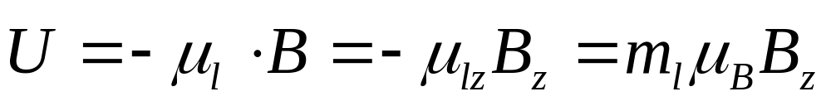
48-5 Atomic Magnetism
If we were to place an atom having a magnetic dipole moment in a magnetic field , which we assume is in the z direction, the energy associated with the interaction between the atom and the magnetic field is
That is, atoms with different values of m_{l} have different energies in the field, which provides a way to determine their orbital angular momentum.

Slide 24
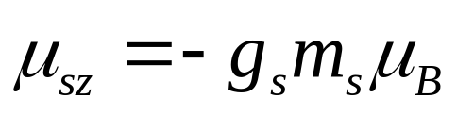
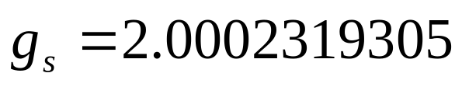
48-5 Atomic Magnetism
For the spin angular momentum, there is no semiclassical corresponding. The full quantum mechanics gives
(48-12)
The Einstein-de Haas experiment

Slide 25
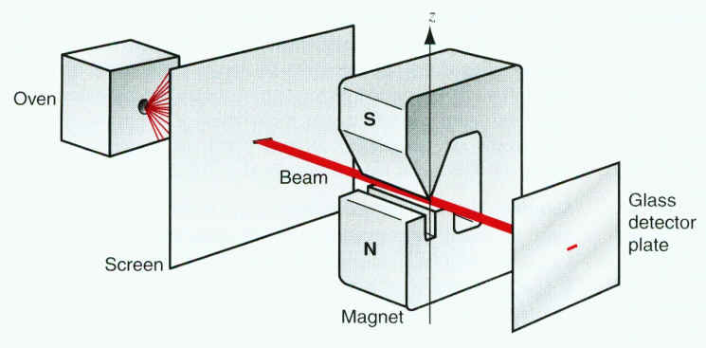
48-6 The Stern-Gerlach Experiment
Verify space quantization predicted theoretically by Wolfgang Pauli.
The Stern-Gerlach Experiment

Slide 26
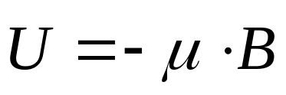
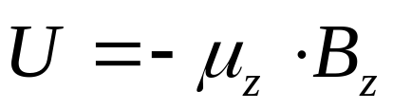
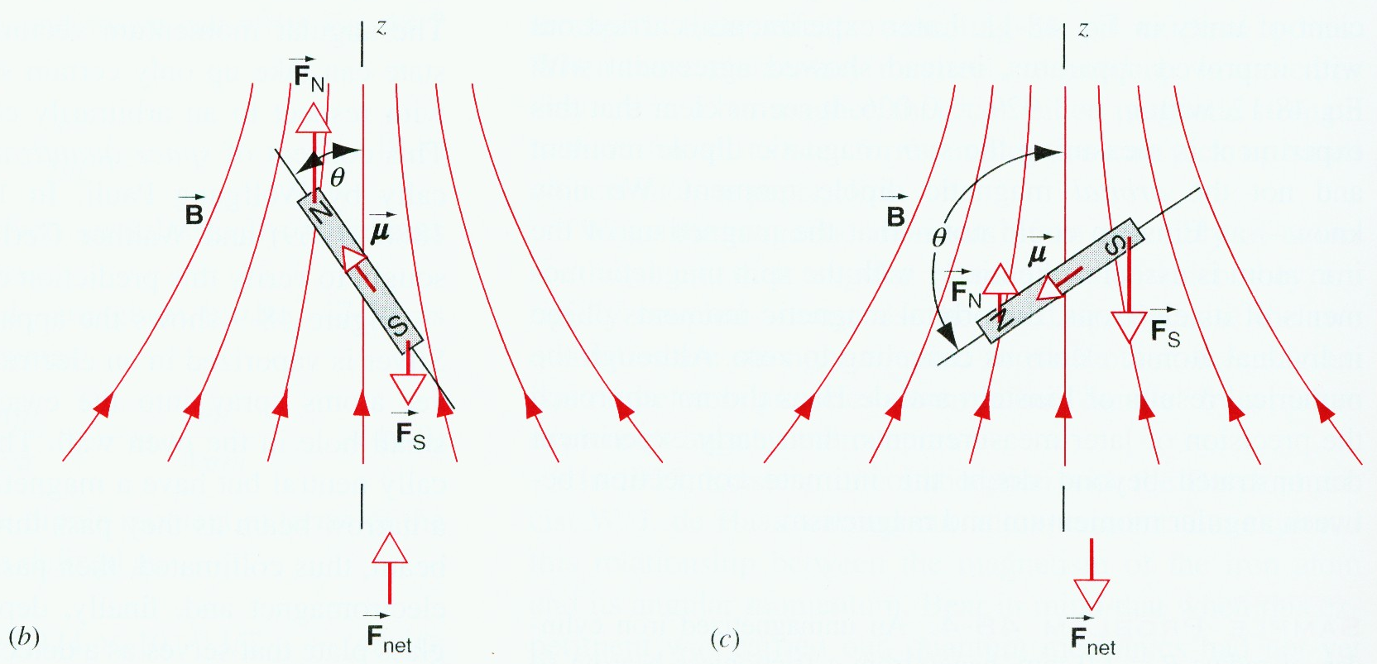
48-6 The Stern-Gerlach Experiment
A Dipole in a Nonuniform Field
(48-13)

Slide 27
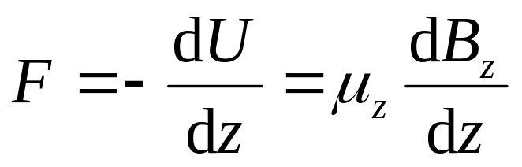
48-6 The Stern-Gerlach Experiment
The net force exerted on the atom is
(48-14)

Slide 28
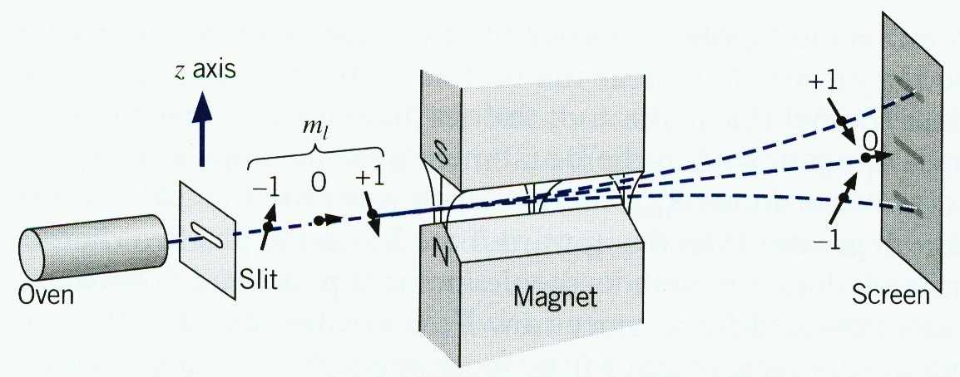
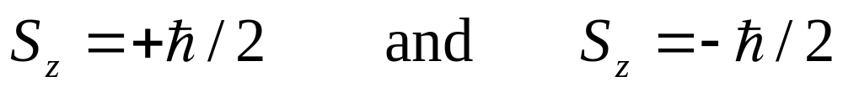
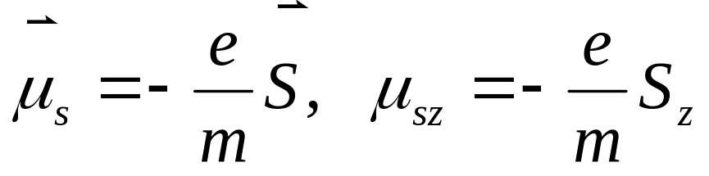
48-6 The Stern-Gerlach Experiment
The experimental results
There are two strips on the plate.

Slide 29
48-6 The Stern-Gerlach Experiment
We know that all the spin and orbital magnetic moments of the electrons in a silver atom cancel, except for those of the atom’s single valence electron. For this electron, the orbital magnetic moment is zero, leaving only the spin magnetic moment. This take up only two orientations in a magnetic field, corresponding to m_{s}= +1/2 and m_{s}= -1/2. Hence there are two subbeams--and not some other number.

Slide 30
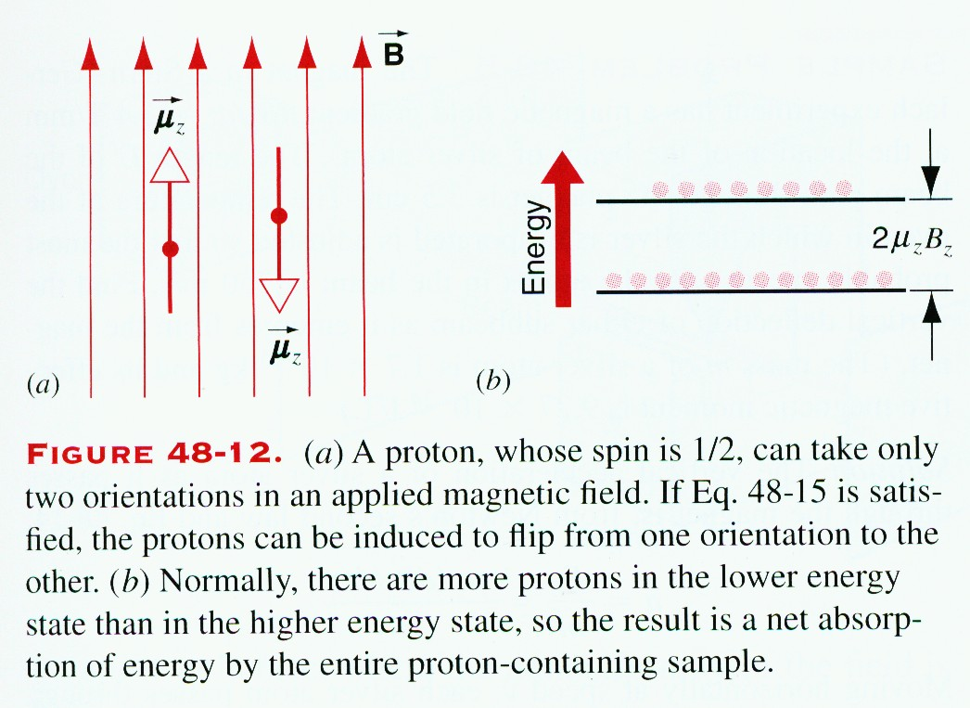
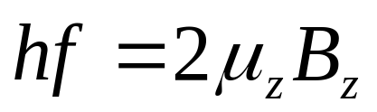
48-7 Nuclear Magnetic Resonance
When a proton is placed in a magnetic field B, its energy can be changed 2μ_{z}B_{z} occurs when its spin magnetic momentum “flips”.
A weak alternating magnetic field with frequency f , its direction is perpendicular to B, is subjected.

Slide 31
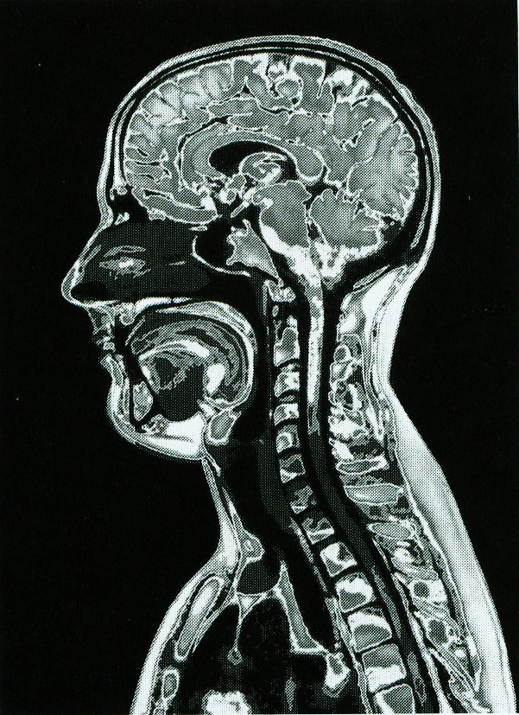
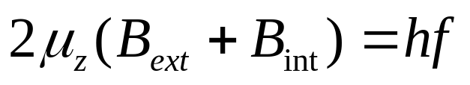
48-7 Nuclear Magnetic Resonance
The resonance condition for a spin flip is

Slide 32
48-8 Magnetism and Atomic Radiation
When we inspect the spectral lines of an atom under high resolution, we often find that what appears to be a single line is actually a pair of very closely spaced lines.
Fine structure of the spectral line

Slide 33
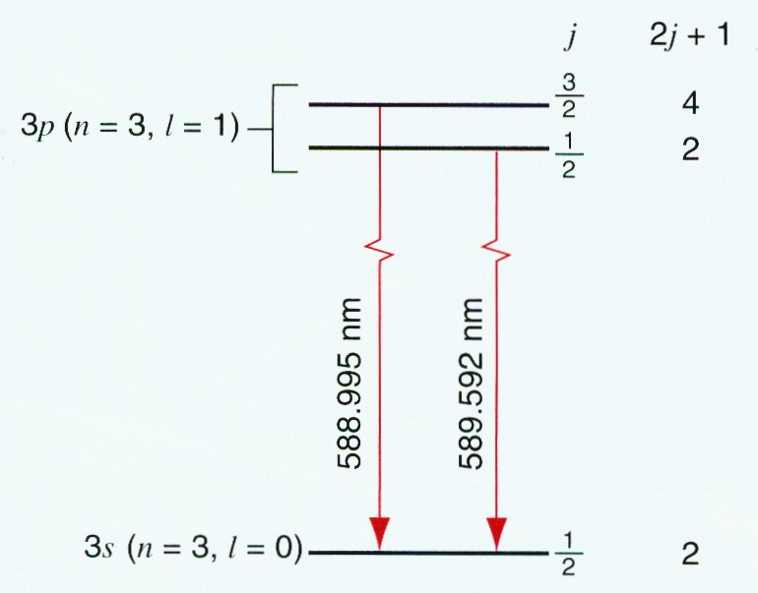
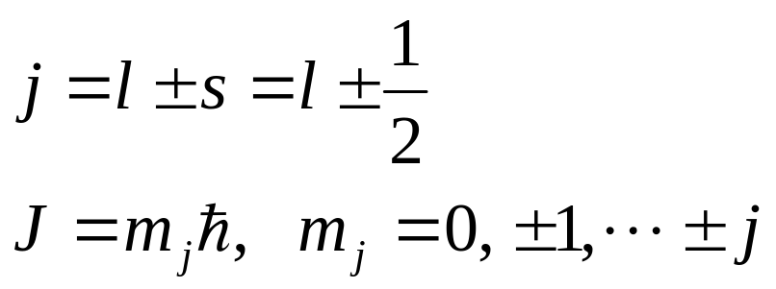
48-8 Magnetism and Atomic Radiation
Sodium atom (Z=11)
Sodium doublet: fine structure
Total angular momentum quantum number j

Slide 34
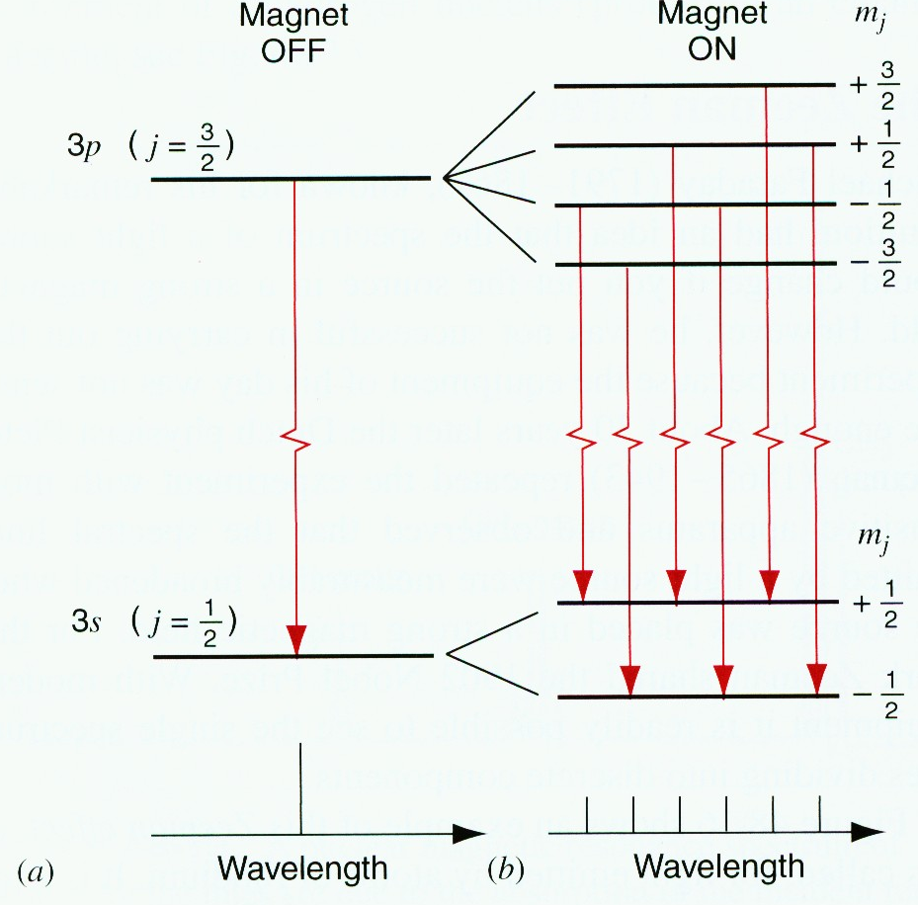
48-8 Magnetism and Atomic Radiation
The Zeeman effect
When the light source is placed in a strong magnetic field, the single spectrum lines dividing into discrete components.

Slide 35
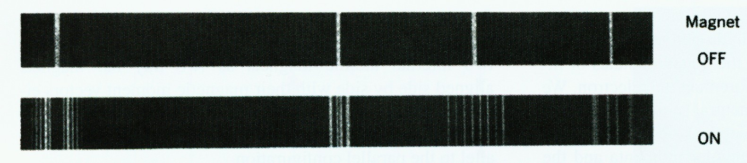
48-8 Magnetism and Atomic Radiation
The Zeeman effect in rhodium.

Slide 36

48-9 Lasers and Laser Light
Four properties
1) Laser light is highly monochromatic.
2) Laser light is highly coherent
3) Laser light is highly directional
4) Laser light can be sharply focused.

Slide 37
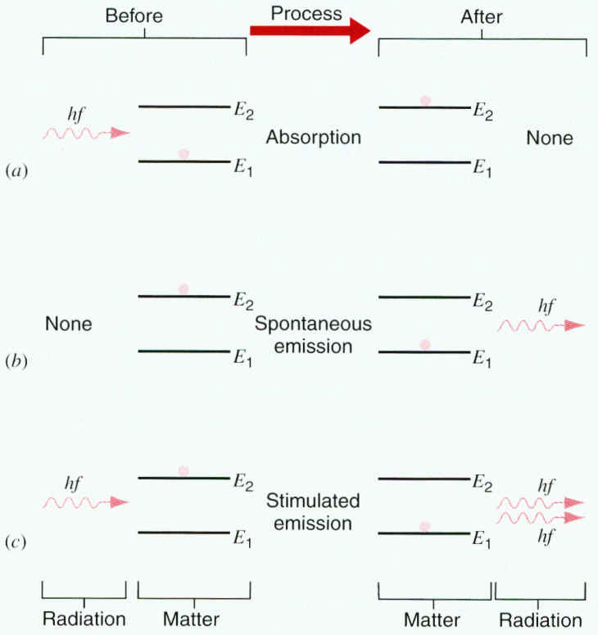
48-9 Lasers and Laser Light
Mechanism
A new concept “simulated emission” is introduced by Einstein

Slide 38
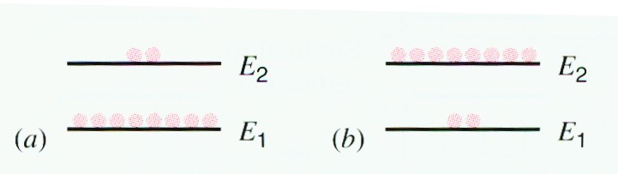
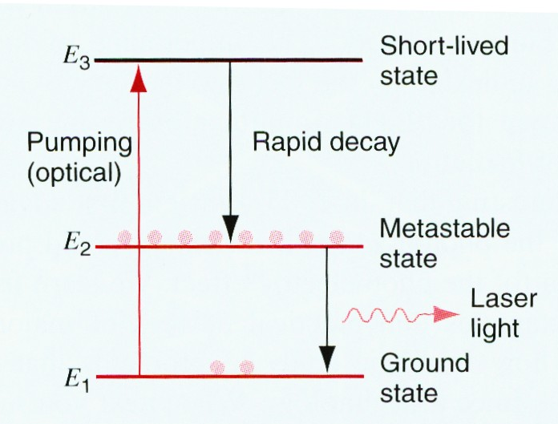
48-9 Lasers and Laser Light
Inverted population
Sample problem 48-7 48-8

Slide 39
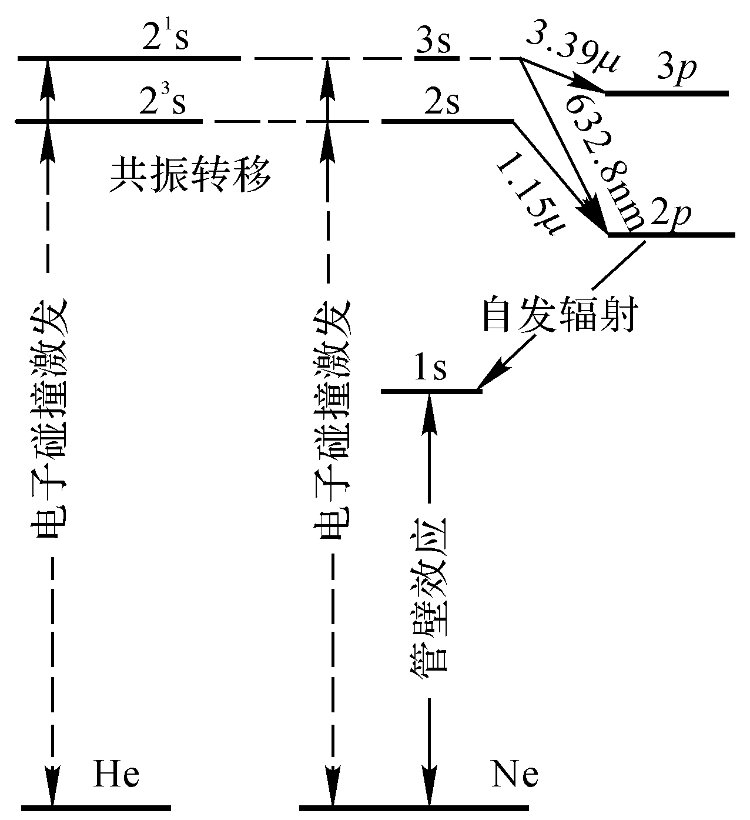
48-9 Lasers and Laser Light
Helium-neon gas laser

Slide 40
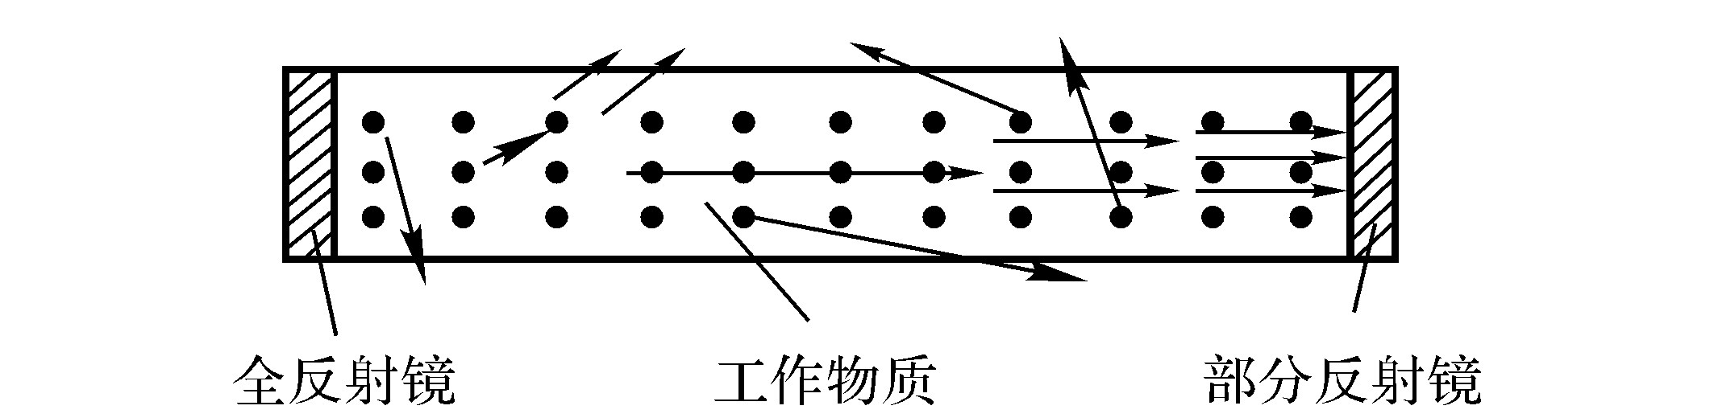
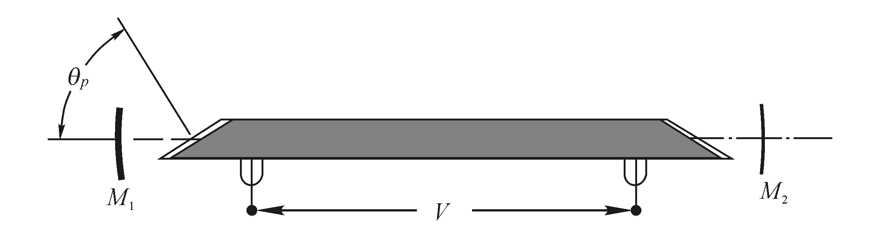
48-9 Lasers and Laser Light
Optical resonant cavity

